Slide 1



SHINE SPEC COMPANY PROFILE

Slide 2
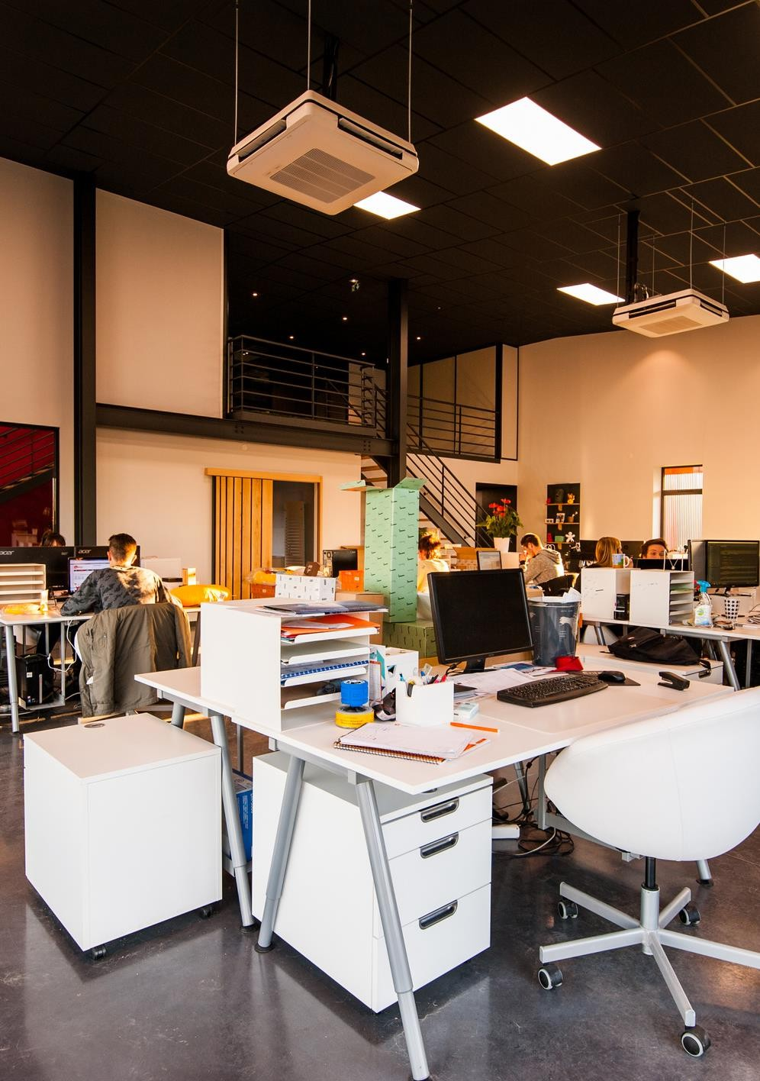












Table of Content

Slide 3






About Company
Founded in 2023, Shine Spec is a professional cleaning company dedicated to creating spotless, healthy, and welcoming spaces for homes and businesses. We pride ourselves on delivering reliable, high‑quality cleaning services that leave a lasting impression.
What We Offer:
🏠 Residential Cleaning – regular, deep, and move‑in/move‑out cleans
🏢 Commercial Cleaning – offices, retail spaces, and business premises
✅ Flexible schedules tailored to your needs
✅ Commitment to professionalism and client satisfaction

Slide 4


Mission
To be the most trusted and sought‑after cleaning partner in South Africa, known for transforming every space into a spotless, healthy, and uplifting environment.
Our Value
Vision
At Shine Spec, our mission is to deliver exceptional residential and commercial cleaning services that exceed client expectations.

Slide 5
Milestones
2023
2024
2025
Launched Shine Spec, delivering professional residential and commercial cleaning services across Gauteng.
Focused on market research, business model, and pricing.
Updating booking software, making sales,

Slide 6

THABO SIZIBA
CEO
ORGANIZATIONAL CHART
SHINE SPEC
xxx
Chief Operating Officer
xxx
Chief Technical Officer
xxx
Senior Software Engineer
xxx
Chief Financial Officer
xxx
Compliance Specialist
xxx
Training Coordinator
xxx
Marketing Director
xxx
Engagement Officer
xxx
Legal Support
xxx
Marketing Intern
xxx
Onboarding Specialist

Slide 7








































































Clear roles ensure our team works efficiently, creatively, and with a shared vision to deliver exceptional results.

Slide 8


Message from the CEO
At Shine Spec, we believe that a clean space is the foundation for comfort, productivity, and peace of mind. Since our launch in 2023, our mission has been simple — to deliver exceptional residential and commercial cleaning services with professionalism, care, and consistency.

Slide 9





Our Service
Residential Cleaning
Commercial Cleaning
Deep Cleaning
Specialized Cleaning
Keeping homes fresh, spotless, and welcoming with tailored cleaning solutions.
Maintaining professional, hygienic workspaces that leave a lasting impression.
Thorough, top‑to‑bottom cleaning for a healthier and revitalised environment.
Expert cleaning for unique needs, including carpets, upholstery, windows, and post‑construction sites.

Slide 10

Business Strategy
STRATEGY 01
Deliver consistently high‑quality residential and commercial cleaning through trained staff, modern techniques, and strict quality control.
STRATEGY 02
Grow our client base by targeting new residential areas and commercial sectors, supported by strong marketing and referral programs.

Slide 11

The Process
1
Consultation & Assessment
We discuss your needs, inspect the space, and create a customised cleaning plan.
2
Professional Cleaning
Our trained team delivers thorough, high‑quality cleaning using safe and effective products.
3
Final Inspection & Feedback
We review the results with you to ensure complete satisfaction and make any final touches.

Slide 12


Key Market Needs for MSME Empowerment
Market Analysis
5%
Commercial Cleaning
Growing Demand – Increased awareness of hygiene and sanitation, especially post‑pandemic, is driving steady growth in both residential and commercial cleaning sectors.
40%
15%
Residential Cleaning
Deep Cleaning
Commercial Sector Dominance – Offices, retail, and industrial facilities account for the largest share of the market, but residential demand is rising fast.
Specialized Cleaning
15%
25%
Other Services
Shift to Specialised Services – Niche offerings like carpet, upholstery, and post‑construction cleaning are gaining popularity as clients seek tailored solutions.

Slide 13









Strengthen our market presence in Gauteng by securing long‑term residential and commercial cleaning contracts.
Expand operations into neighbouring provinces and introduce eco‑friendly cleaning solutions as a core service offering.
Establish Shine Spec as a nationally recognised brand with a reputation for excellence, innovation, and customer satisfaction.

Slide 14

Benefits
Professional Quality Trained staff and proven methods ensure consistently excellent results.
Time Savings We handle the cleaning so you can focus on what matters most.
Health & Hygiene Safe, effective products create a cleaner, healthier environment.
Flexible Solutions Customised cleaning plans to suit your schedule and needs.
Reliable Service On‑time, dependable, and committed to exceeding expectations.

Slide 15







Let's Connect
With Us!

Slide 16
Shine Spec 26/10/2025 Meeting Notes with Malusi
Sweep South Update
3Dots: to verify background, education,
Have predictive cleaning schedule for regular people who’re booking for service
Smartbot for instant bookings via communication
Malusi to do User flows

